Slide 1
雲端計算
Cloud Computing
Lab–Windows Azure

Slide 2
Agenda
Introduction
  Background of Windows Azure
Installation
  Getting started
  Sample
Two Exercises
  GuestBook
  LotteryG

Slide 3

Introduction
Microsoft’s Windows Azure is one of popular PaaS provider.
Windows Azure start general availability at Feb 2010, and construct the global data center location at seven country.
It is based on .NET and Microsoft’s supported development tools.

Slide 4
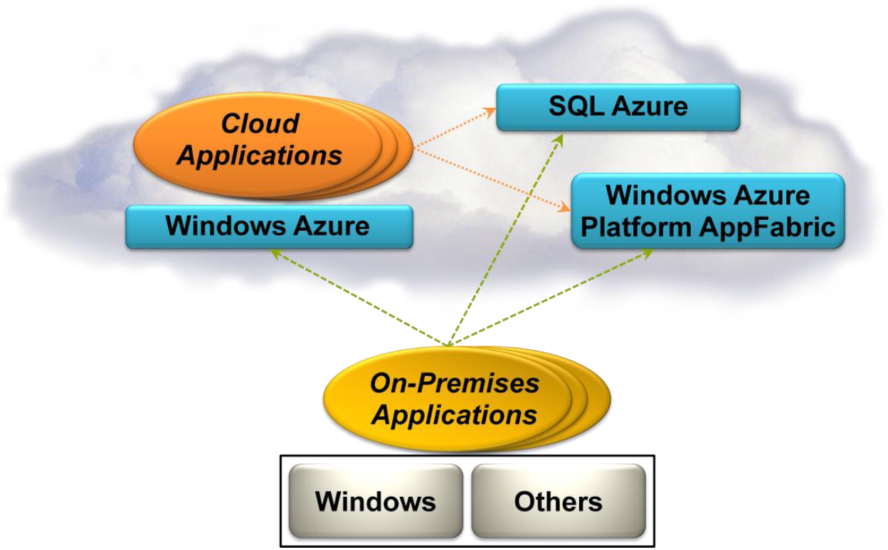
Azure
Basic cloud environment
Database
Communication
Security

Slide 5
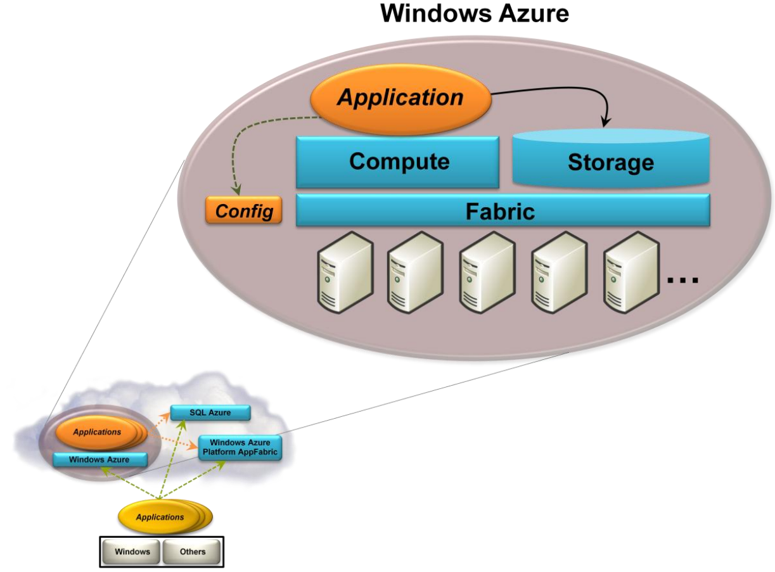
Windows Azure

Slide 6
Lab Goal
Storage Space
Computation Role
AppFabric
Other service
…
service
Request
Web
Role
Queue
Worker Role
Messgae
Storage
Web page

Slide 7
Lab
Storage Space
Computation Role
AppFabric

Slide 8
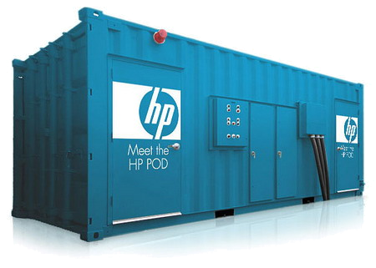
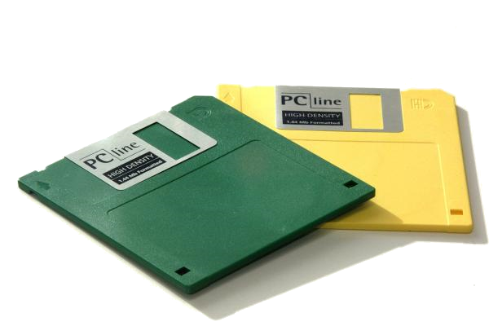
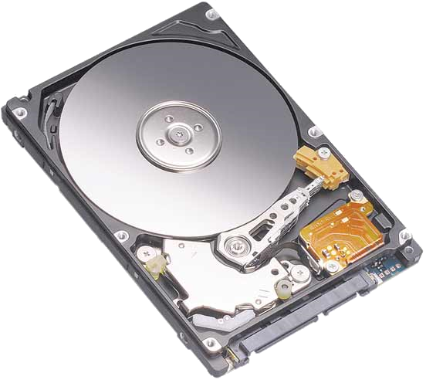
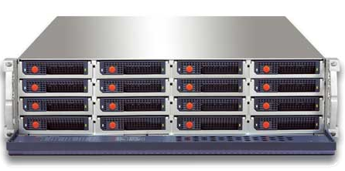

Storage Space

Slide 9
Storage Space
Azure provides three type of storage and each one provides a special purpose
Blob
  Provide blocks of storage that can store text or binary file.
Table
  Provide structured-based storage.
Queue
  Provide slices storage that supports communication between roles.

Slide 10
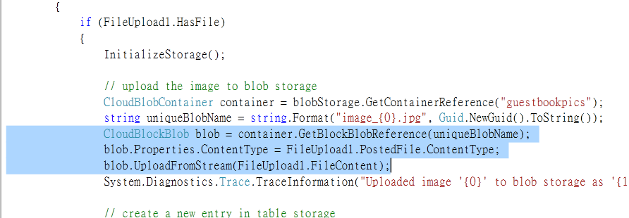
Blob
Account
Container
Blob

Slide 11
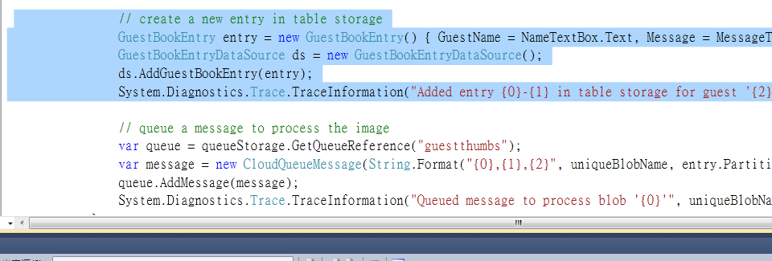
Table
Partition Key
Class
Row Key
Number
Property 1
Score 1
Property 2
Score 2
Table A
Class A | No 1 | A | A+
Class A | No 2 | B- | B-
Class B | No 1 | B+ | A-
Class B | No 2 | B+ | B+
Class B | No 3 | A | A-
Partition 1
Partition 2

Slide 12
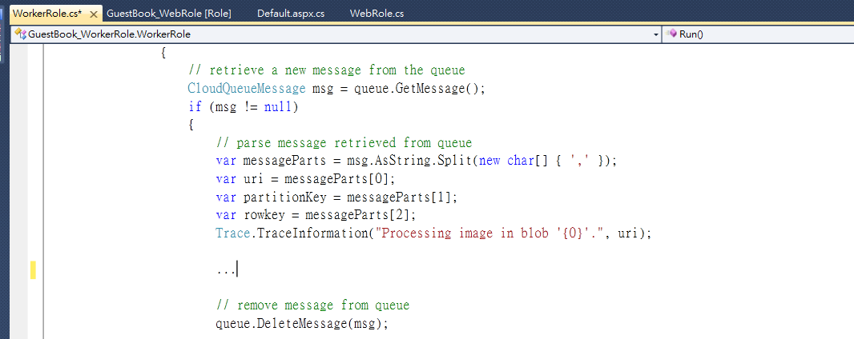
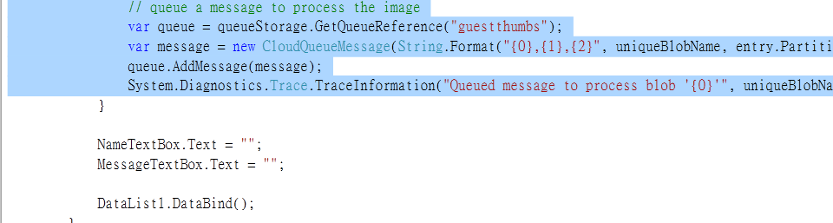
Queue
Web
Worker
Web
Queue
Worker
Web
Worker

Slide 13
lab
Storage Space
Computation Role
AppFabric

Slide 14
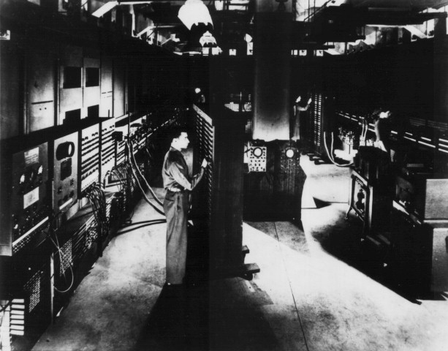
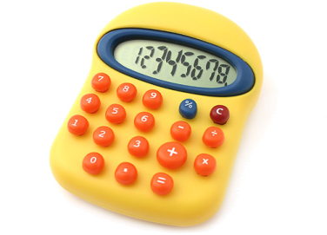
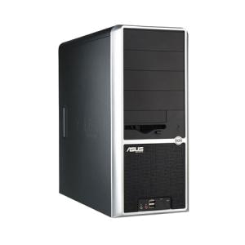
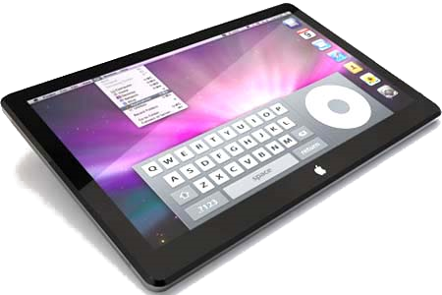
Computation

Slide 15
Computation
Azure provides the computation platform for variety of services and a running environment of IIS 7 and .NET.
Web role
  Provide a web application service or social-interaction.
  Process the user’s request.
Worker role
  Handle the complexity or distributed computation.
  Return the result to web role.

Slide 16
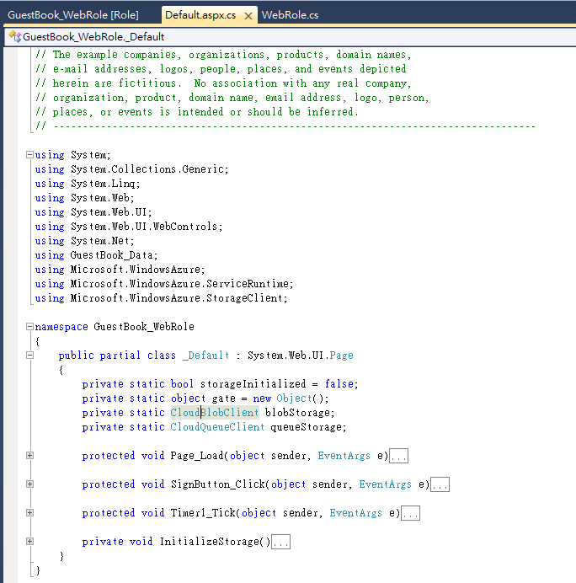

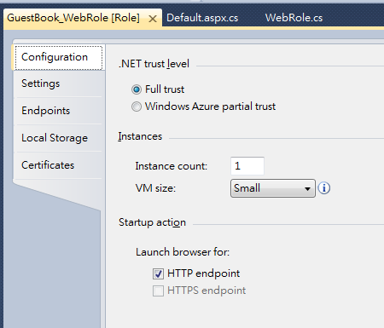
Web Role

Slide 17
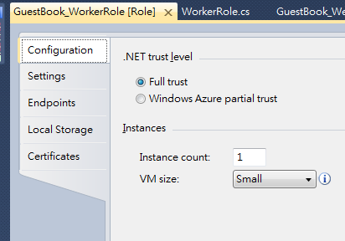
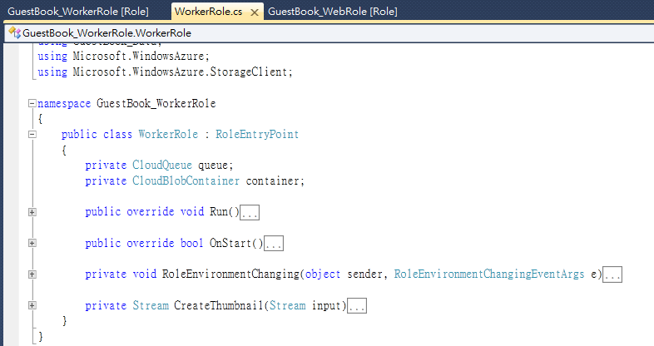


Worker Role

Slide 18
lab
Storage Space
Computation Role
AppFabric

Slide 19
AppFabric
Service Bus
  Makes connection simpler by letting an application expose endpoints that can be accessed by other applications
Access Control
  Provides the ability for applications with authentication and authorization

Slide 20
Client vs. Service
Service Consumer
Service Provider
Client
Web Service
Service
Function
Function

Slide 21
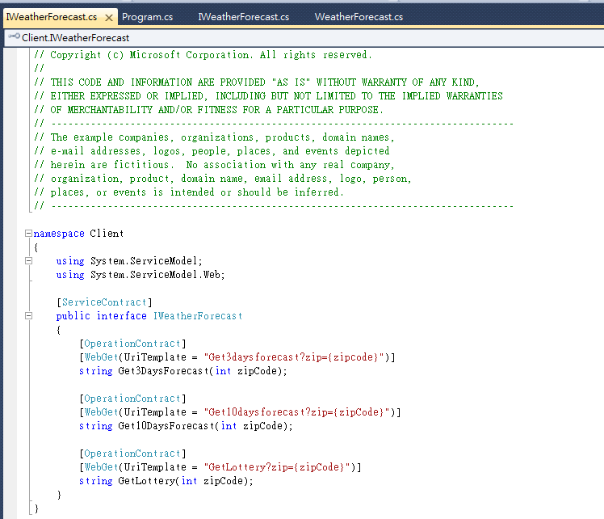
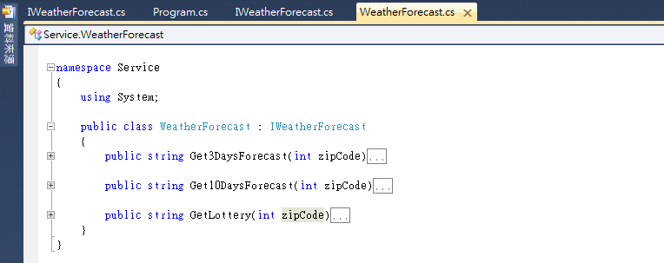

AppFabric

Slide 22
Installation
Getting started
Sample

Slide 23
System Requirements
Supported Operating Systems
  Windows 7, Windows Server 2008, Windows Server 2008 R2, or Windows Vista
Development environment
  Microsoft Visual Studio 2010, Upgrade Microsoft Visual Studio 2008 to Service Pack 1, or Install Microsoft Visual Web Developer 2010 Express
  .NET framework 3.5+
  IIS 7.0
  Windows Azure Tools 1.2 (June 2010)

Slide 24
Install Steps
Install Visual Studio 2010 Express or Visual Web Developer 2010 Express
  SQL Server 2008 Express & .NET framework 4.0 were installed as part of Visual Studio
Enable IIS7 with ASP.NET and WCF HTTP Activation
  According to your OS version
Install the Windows Azure Tools 1.2
  VSCloudService.exe
Azure Storage Explorer
  AzureStorageExplorerSetup.msi

Slide 25
Download
Major
  Visual Studio 2010 or Visual Web Developer 2010 Express
  Windows Azure SDK
  Azure Storage Explorer
Optional
  .NET framework (3.5+)
    http://www.microsoft.com/downloads/en/details.aspx?FamilyID=9cfb2d51-5ff4-4491-b0e5-b386f32c0992&displaylang=en
  Microsoft IIS 7
    http://www.iis.net/download
  ASP.NET
    http://www.asp.net/

Slide 26
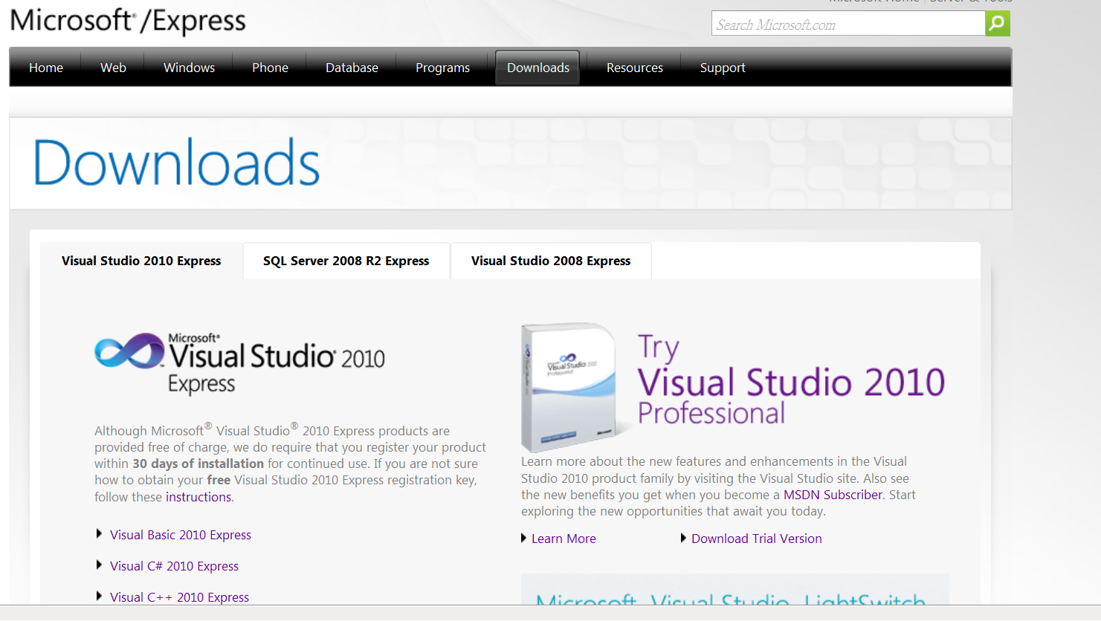
Visual Studio
Use browser(like IE or Firefox ) and link to
  http://www.microsoft.com/express/Downloads/

Slide 27
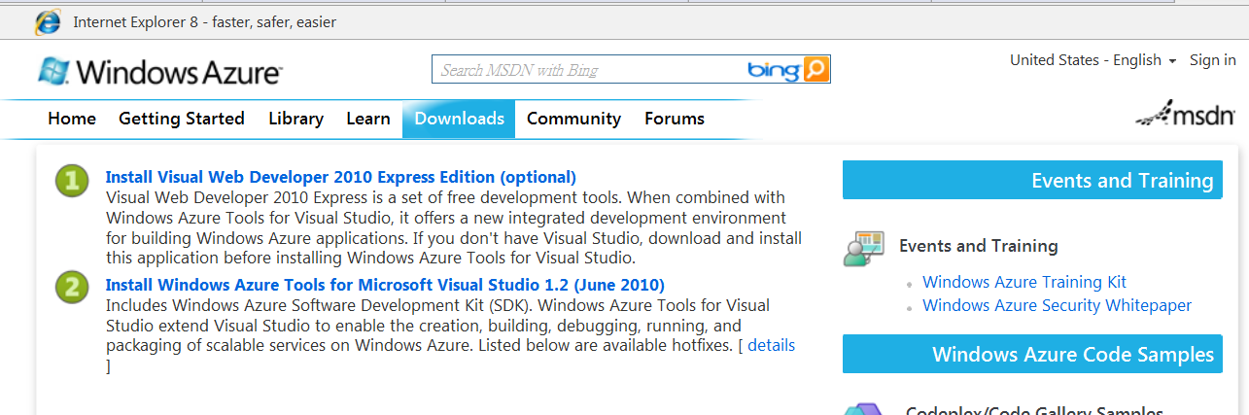
Azure SDK
Use browser(like IE or Firefox ) and link to
  http://msdn.microsoft.com/en-us/windowsazure/default.aspx
Choose Downloads
SDK

Slide 28
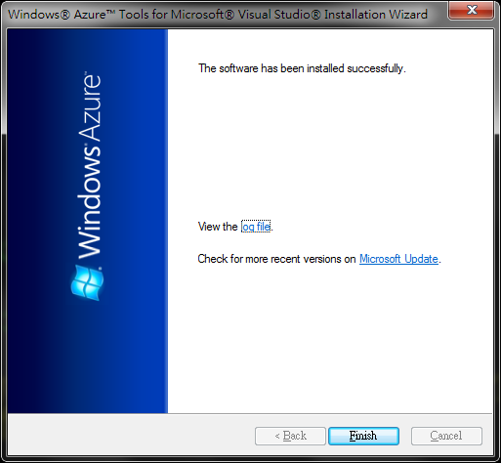
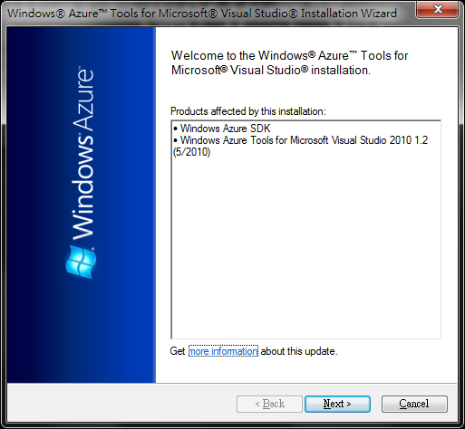
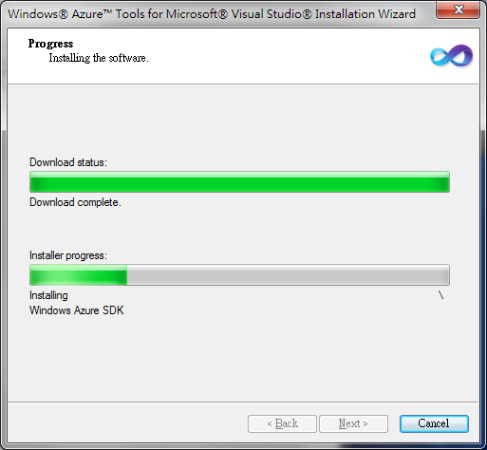
Azure SDK (cont.)
Run the Azure SDK.
Press Next as default.
Download the Azure tools automatically.
Ready to start.

Slide 29
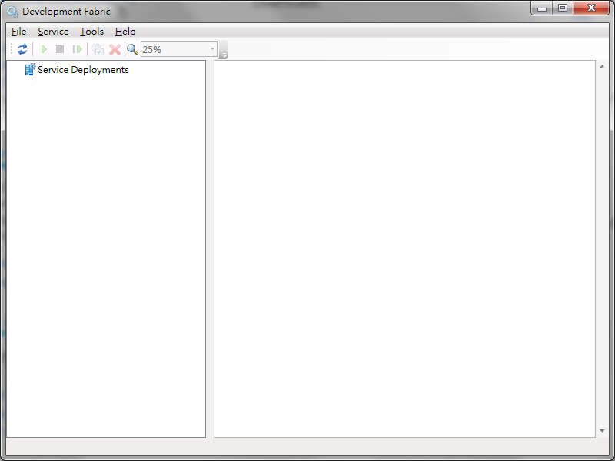
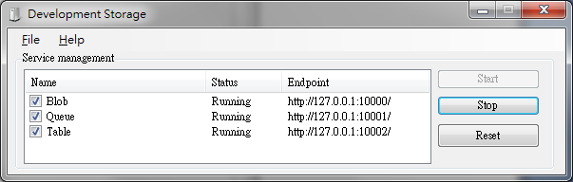
Azure SDK (cont.)

Slide 30
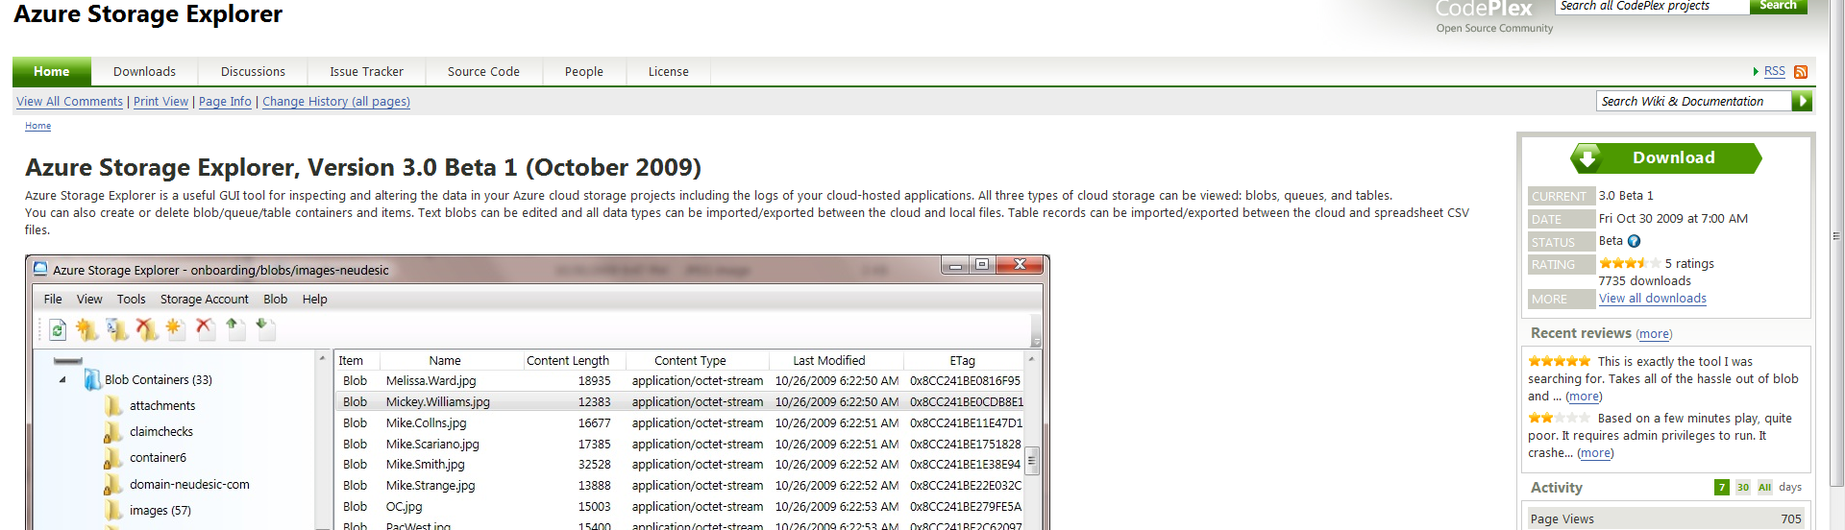
Azure Storage Explorer
Use browser (like IE or Firefox ) and link to
  http://azurestorageexplorer.codeplex.com
Download Azure Storage Explorer.

Slide 31
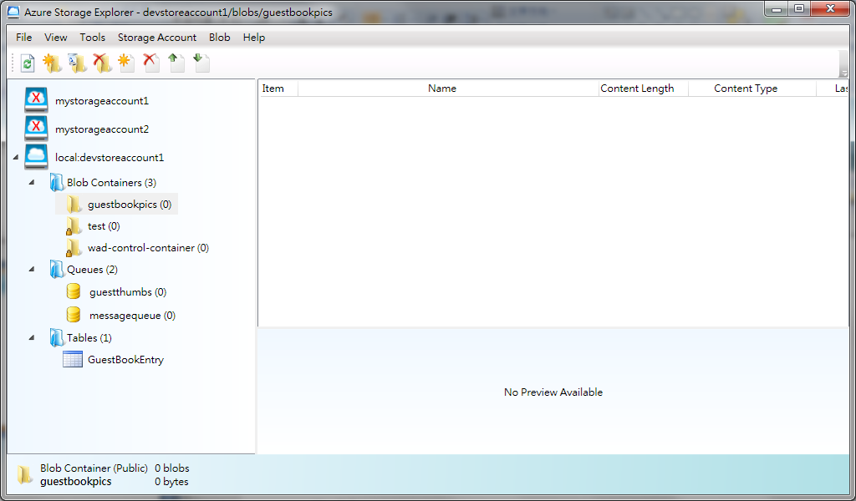
Azure Storage Explorer

Slide 32
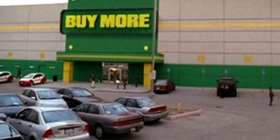
More and more
… and more

Slide 33
Installation
Getting started
Sample

Slide 34
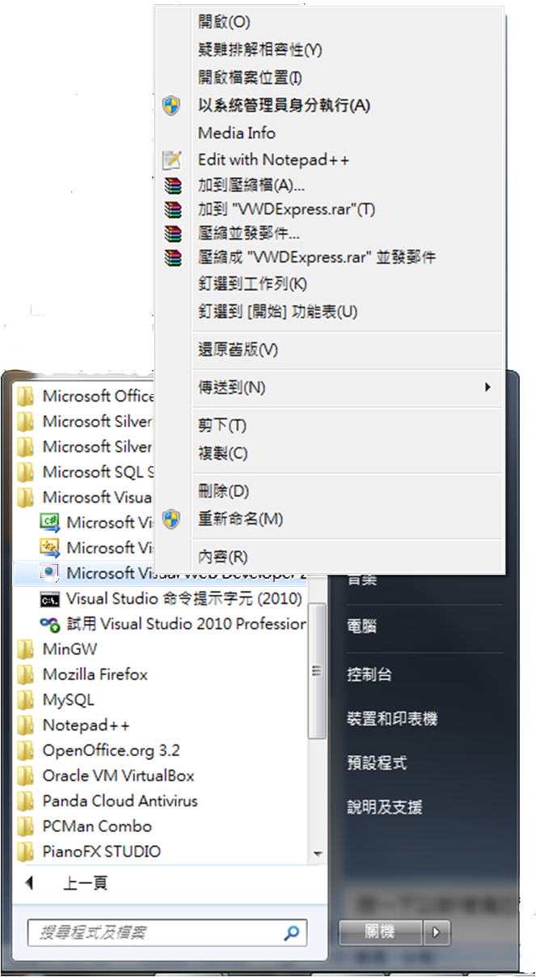
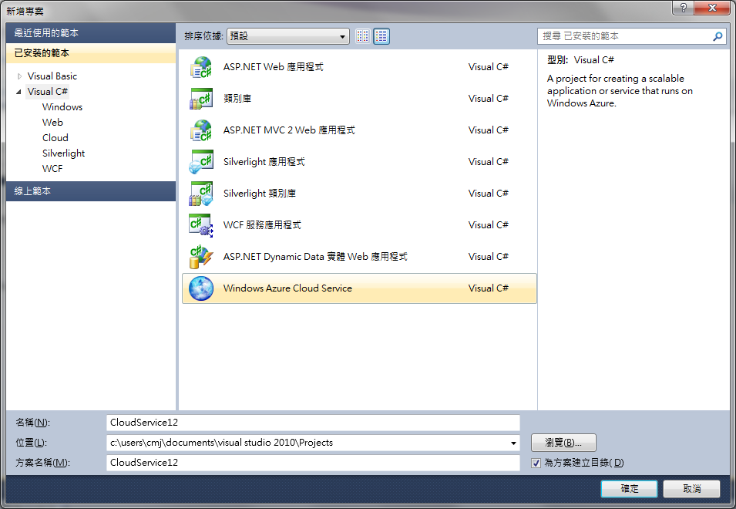
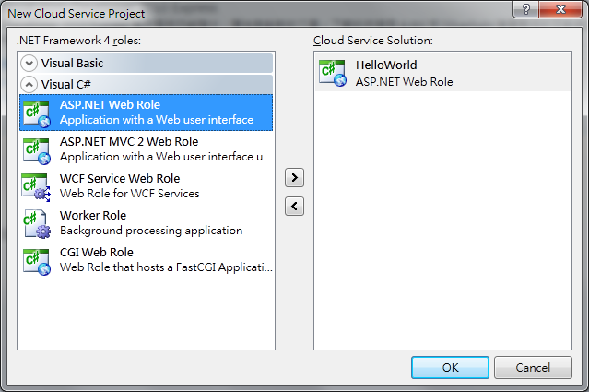
Step by Step(1)
Run Web Developer (by admin).
Create a new project (Cloud service)
Select ASP.NET
Web Role

Slide 35
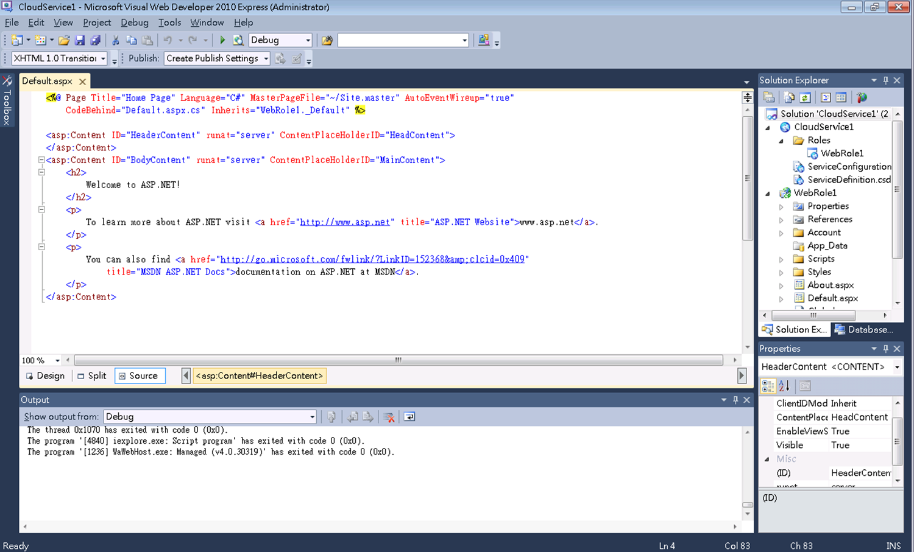
Step by Step(2)

Slide 36
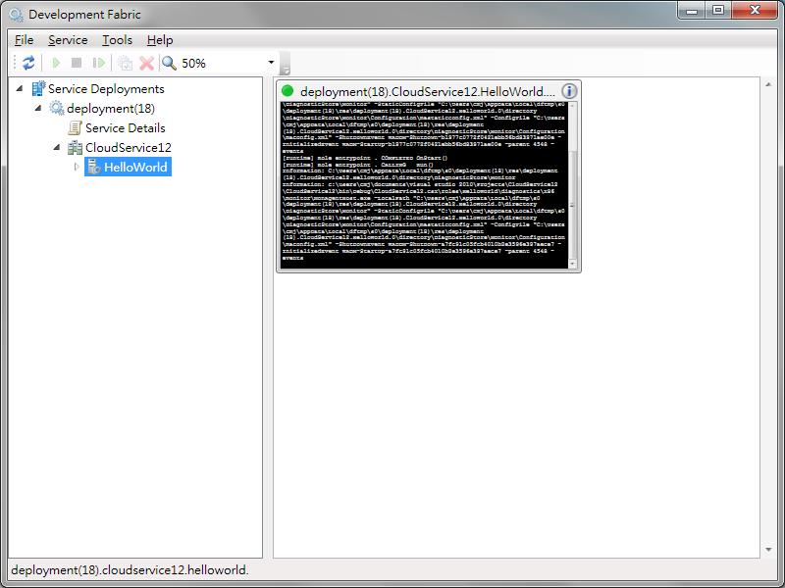
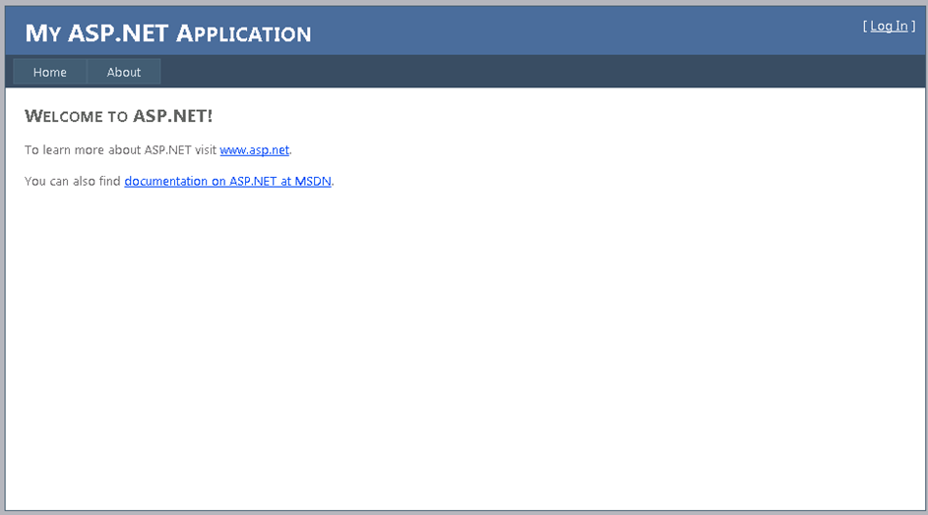
Step by Step(3)
Running
  Enter F5 for building project.
  After about 30 seconds.
  Get a web page.

Slide 37
More Information
Detail Instructions
  http://www.microsoft.com/downloads/en/details.aspx?displaylang=en&FamilyID=2274a0a8-5d37-4eac-b50a-e197dc340f6f
Windows Azure Platform Training Kit
  http://www.microsoft.com/downloads/en/details.aspx?FamilyID=413e88f8-5966-4a83-b309-53b7b77edf78&displaylang=en

Slide 38
Lab - 1
GuestBook

Slide 39
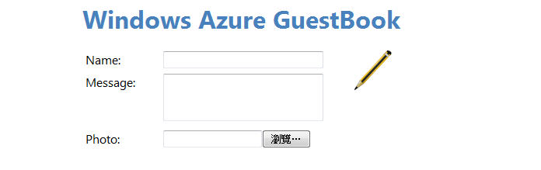
Overview

Slide 40
Overview
This lab will show you how to create an Azure application.
  Web role and Worker role
  Blob, Table, and Queue
Project
Request
Web
Role
Queue
Worker Role
Messgae
thumbnail
original image
Upload
Storage
Web page
Input data
Name, Image, …etc

Slide 41
Step 0
Test environment

Slide 42
Test Environment
Windows 7 (32bit)
Microsoft Visual Web Developer 2010 Express
Windows Azure SDK
Azure Storage Explorer
… and more

Slide 43
Step 1
Test environment
Create a project

Slide 44
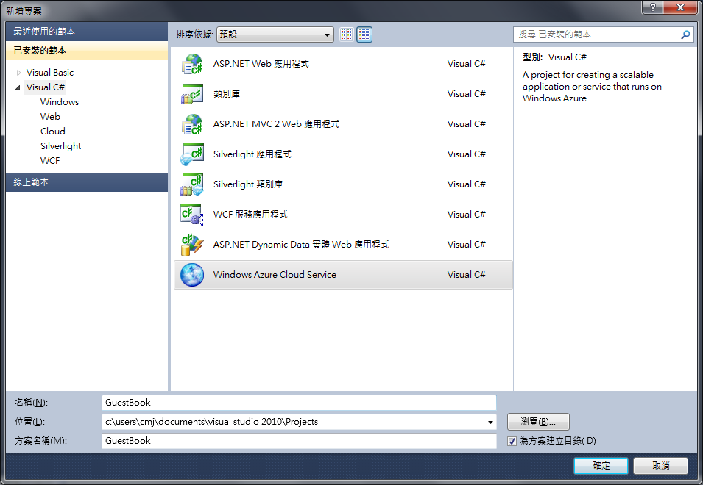
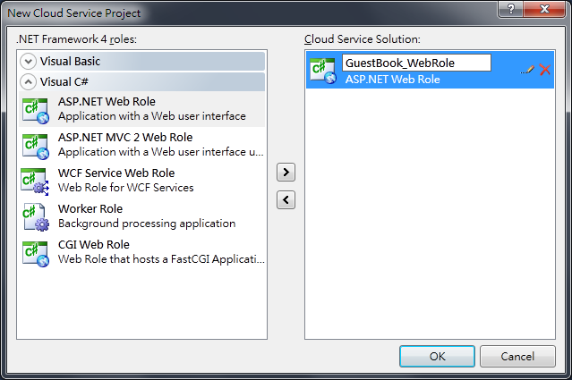
Step by Step(1)
Run Web Developer (by admin).
Create a new project (Cloud service)
Select Web Role

Slide 45
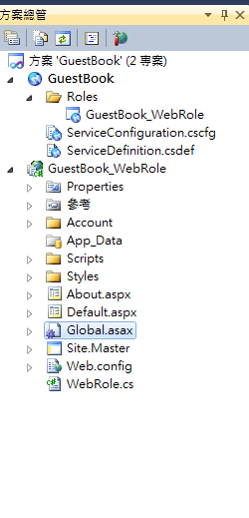
Step by Step(2)
GuestBook
  holds the configuration for the web and worker roles that compose the cloud application.
GuestBook_WebRole
  a standard ASP.NET Web Application project template modified for the Windows Azure environment.

Slide 46
Result
Project
Web
Role

Slide 47
Step 2
Test environment
Create a project
Create data model

Slide 48
Introduction
Blob
Blob
  Original image
  Thumbnail image
Table
  Messgae
  GuestName
  PhotoURL
  ThumbnailUrl
  TimeStamp (automatic)
p1
p2
Address
Storage
Table

Slide 49
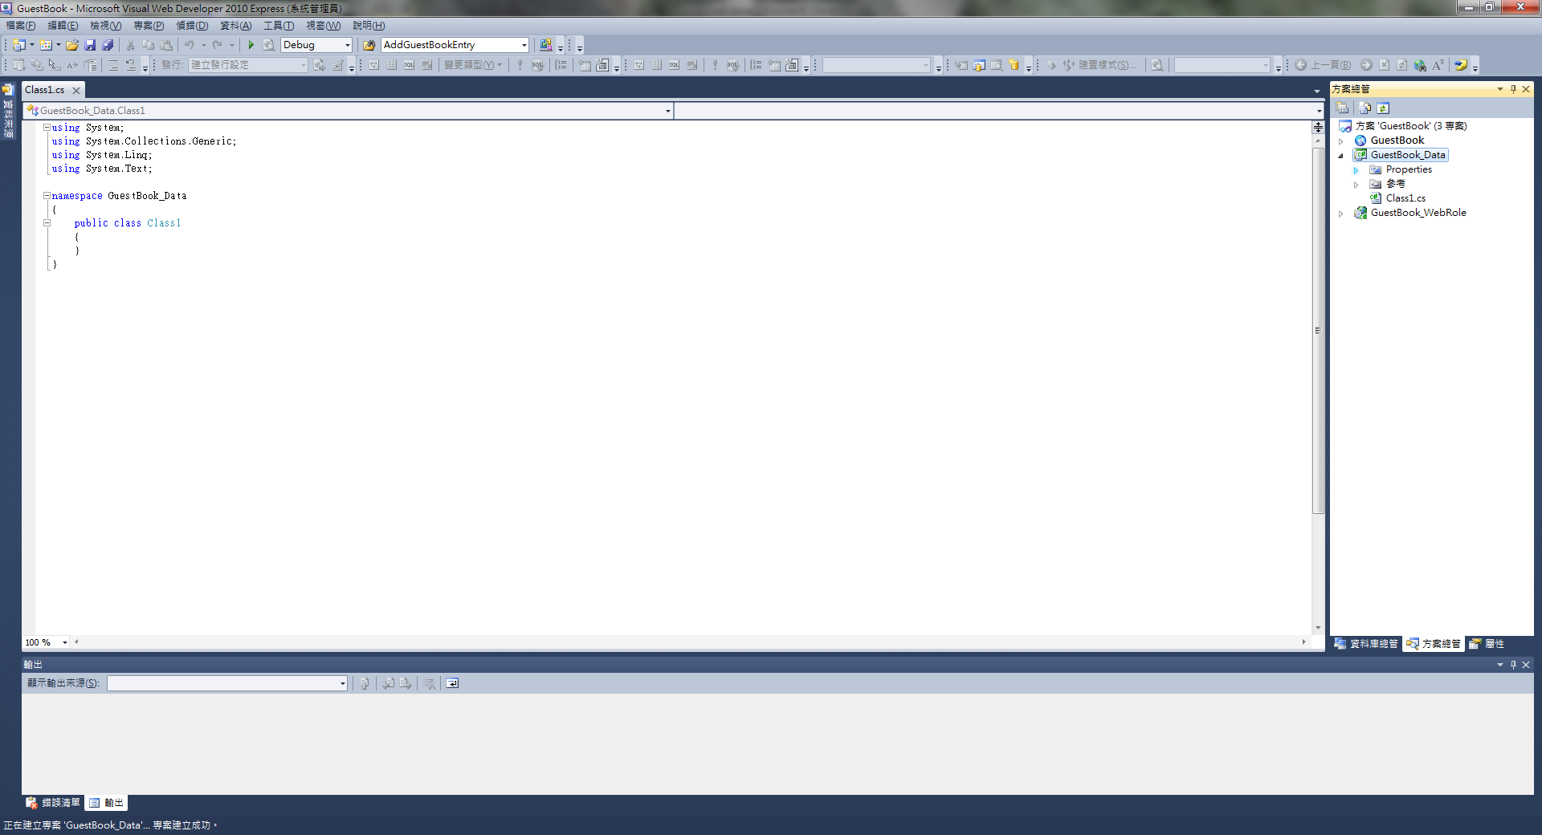
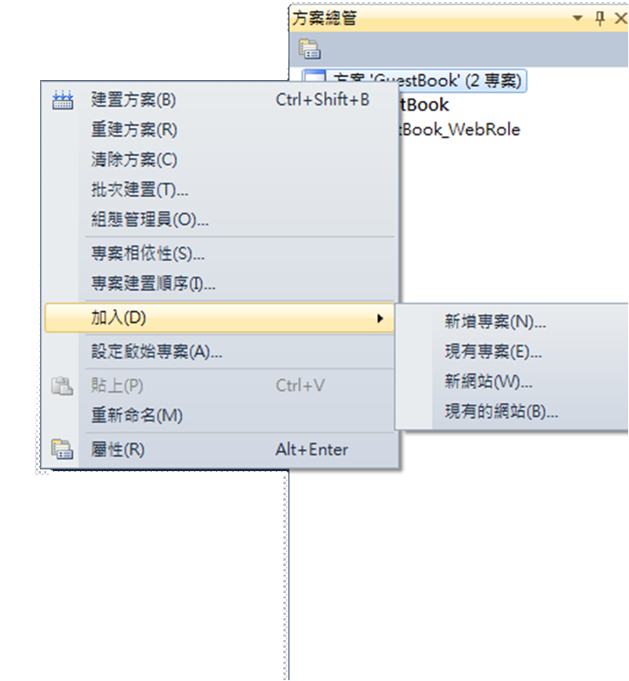
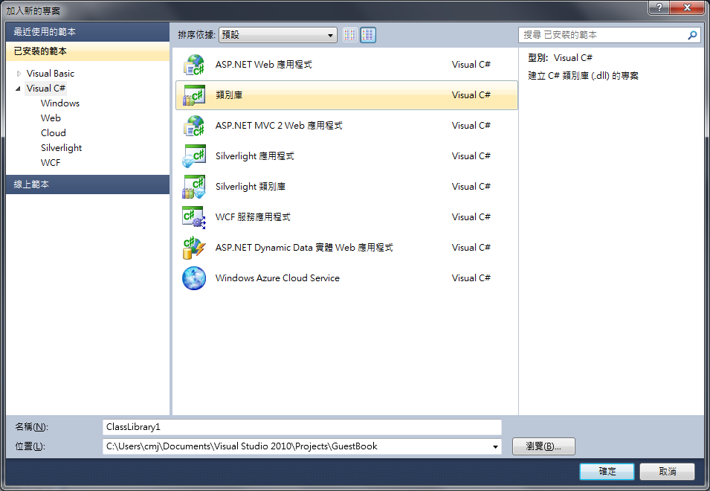
Step by Step(1)
Add a new project in Solution Explorer.
Select the Class Library.
Enter the name GuestBook_Data

Slide 50
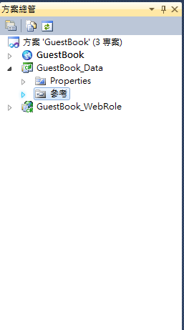
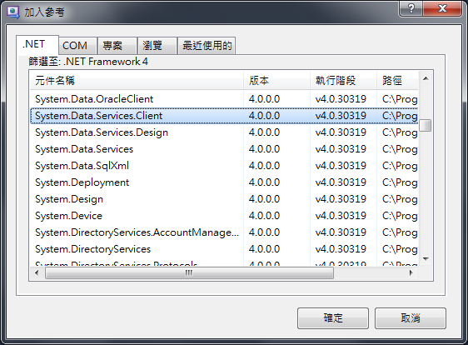
Step by Step(2)
Delete the default class Class1.cs.
Add a reference to the .NET Client Library for ADO.NET Data Services.
  System.Data.Services.Client
  Microsoft.WindowsAzure.StorageClient

Slide 51
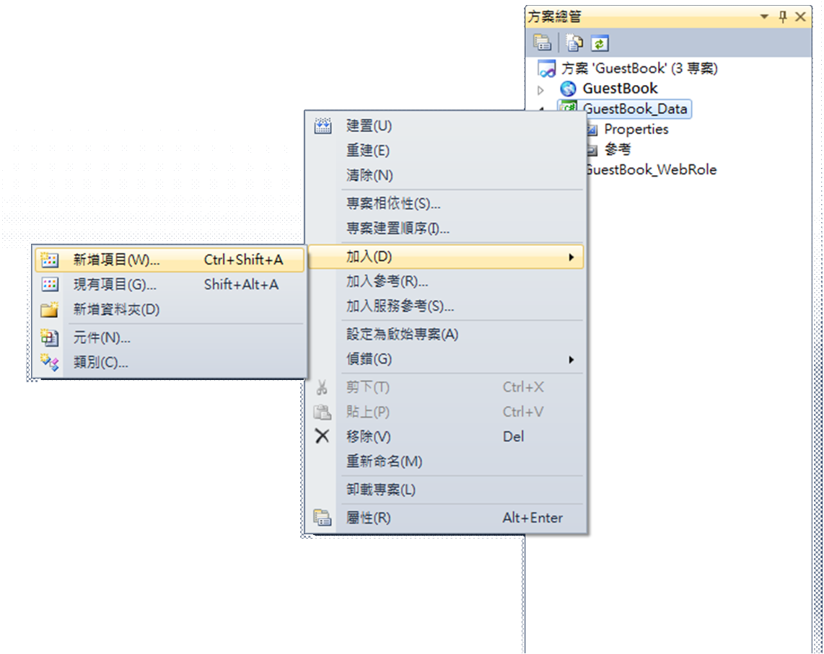
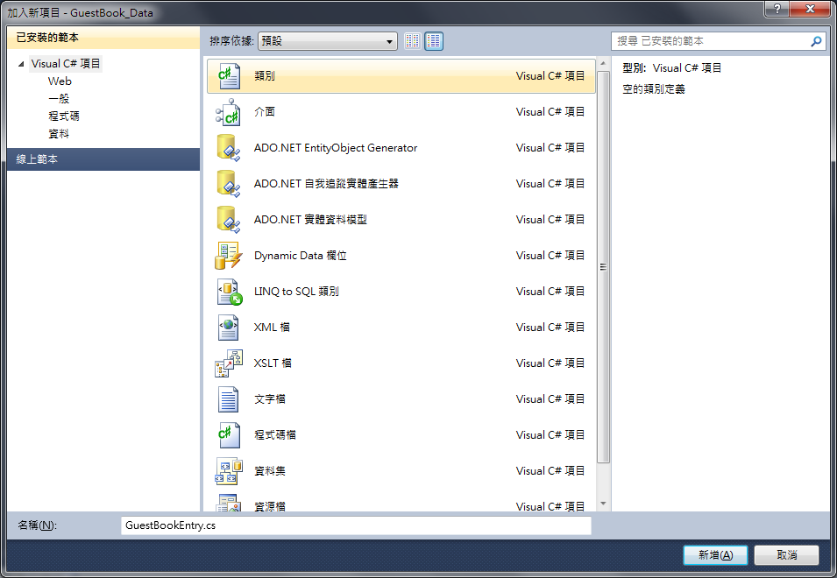
Step by Step(2)
Add a new item and select Class.
Set the name to GuestBookEntry.cs.
Open GuestBookEntry.cs

Slide 52
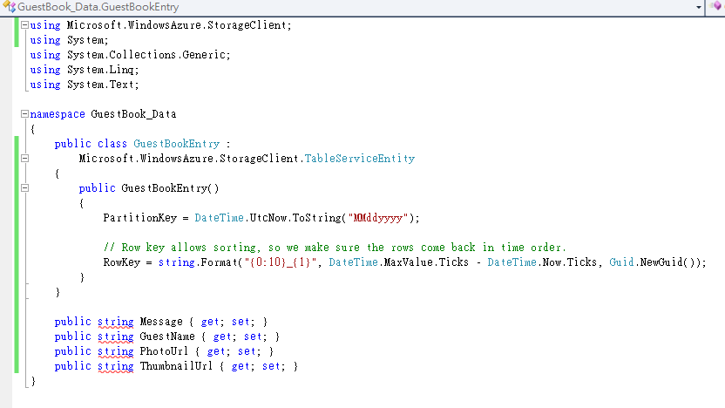
Step by Step(3)
Insert the following codes.
Library
Table
Entry ID
Entry

Slide 53
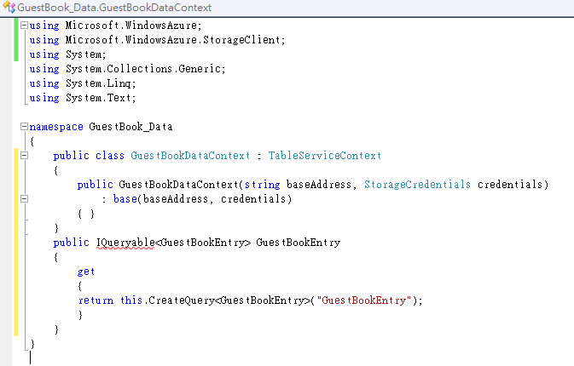
Step by Step(4)
Add a new item and select Class.
Set the mane to GuestBookDataContext.cs.
Open and insert the following codes.
Log Table and
creates a table

Slide 54
Step by Step(5)
Add a new item and select Class.
Set the mane to GuestBookEntryDataSource.cs .
Open and Insert the following codes.
Five functions
  Constructor
  Initialize
  method to return the contents.
  method to insert new entries.
  update the thumbnail URL property.

Slide 55
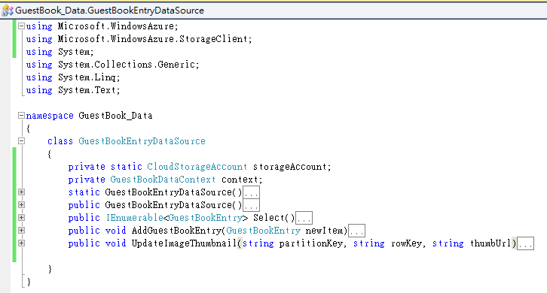
Step by Step(5)(cont.)
Initialize
Constructor
Add a new entry
Return the entries
Update the thumbnail address

Slide 56
Result
Project
Web
Role
original image
Upload
Storage
Input data
Name, Image, …etc

Slide 57
Step 3
Test environment
Create a project
Create data model
Worker Role

Slide 58
Introduction
A worker role runs in the background
  Provide services
  Execute time related tasks
Receive a message from web role, creates a thumbnail, and update the thumbnailURL
Worker Role
thumbnail
original image
Upload

Slide 59



Step by Step(1)
Add a new Worker Role.
Set the name to GuestBook_WorkerRole.
Add reference
  GuestBook_Data from project.
  Change to .NET
    System.Drawing
    Microsoft.WindowsAzure.StorageClient

Slide 60

Step by Step(2)
Queue
Major part
Initialize
Create the thumbnail

Slide 61
Run() of Worker Role
Receive message from queue.
Parse message.
Download the original image from blob.
Create the thumbnail image and upload.
Update the thumbnail URL.
Delete message from queue.
Parse message
Message
Worker Role
Create thumbnail
Download
original image
Upload image and
Update thumbnailURL

Slide 62
Result
Project
Web
Role
Queue
Worker Role
Messgae
thumbnail
original image
Upload
Storage
Input data
Name, image, …etc

Slide 63
Step 4
Runtime environment
Create a project
Create data model
Worker Role
Web Role

Slide 64
Introduction
A web role runs as interface
  Receive request from user.
  Upload message and image in storage space.
  Return the response by web page.
Request
Web
Role
Web page
Input data
Name, Image, …etc

Slide 65




Step by Step(1)
Add reference
  Microsoft.WindowsAzure.StorageClient from .NET
  GuestBook_Data from project
Delete Default.aspx.
Add and select Existing Item

Slide 66
Step by Step(1)
Reduce the effort of developing web page.
  Composition of web page.
  Upload message and image.
  Response of web page.
Request
Web
Role
Web page
Input data
Name, Image, …etc

Slide 67

Step by Step(2)
Upload
Initialize
periodically refresh web page

Slide 68

Step by Step(3)

Slide 69

Step by Step(4)
set up the environment

Slide 70
Step 5
Runtime environment
Create a project
Create data model
Worker role
Web Role
And more

Slide 71



Slide 72

Spec.
A more detailed description
  \Lab\IntroductionToWindowsAzureVS2010\Lab.docx

Slide 73
Demo

Slide 74
Instruction
Use Storage Explorer to observe the blob, table, and queue in storage space.
Use Development Fabric to observe the status of web role and worker role.
Some failure can occur as we expect.

Slide 75
Demo
Storage

Slide 76



Storage Explorer
Blob containers.

Slide 77




Storage Explorer
Tables

Slide 78

Related Information

Slide 79
Demo
Storage
Web Role and Worker Role

Slide 80


Development Fabric

Slide 81

Web Role

Slide 82

Worker Role

Slide 83
Demo
Storage
Web Role and Worker Role
Failure

Slide 84

Error
Storage Service
Error!

Slide 85

Error
Start the development storage service

Slide 86
Exercise

Slide 87
Exercise
Grab some messages from queue.
  Web role sends message to worker role across queue.
  Grab message(s) from any point of web role or worker role.
  Use Storage Explorer or something to show the message.
Extend the entry from Table.
  Add some column, like IP or a series number in Table.
  Show the result by Storage Explorer or Web Page.

Slide 88
Hand-in Requirements
Report
  Methodology
    How to
    Screenshot
  Lesson learn and discussion
Anything can improve your grade
  E.g. more functionalities

Slide 89
Lab - 2
LotteryG

Slide 90
Outline
HTTP
  Basic knowledge
  Request methods of web service
AppFabric
  Hand-on Lab
Lab – Lottery G
  A simple web service

Slide 91
HTTP

Slide 92


HTTP
Request
Response

Slide 93
HTTP Method
Request methods
  HTTP defines twelve methods indicating the desired action to be performed on the identified resource.
GET
  Requests a representation of the specified resource by some special URL address.
POST
  Submits data to be processed to the identified resource.

Slide 94


HTTP Method
http://www.google.com.tw/
http://www.google.com.tw/
search?hl=&q=SSlab&sourceid=navclient-ff&rlz=1B3GGLL_zh-TWTW387TW387&ie=UTF-8
Request
Response
GET method
POST method

Slide 95
Get Method
GET /webhp?hl=zh-TW HTTP/1.1
Host: www.google.com.tw
A blank line
The request ends with a double newline.
Target server
Use GET method to request a web page: webhp?hl=zh-TW

Slide 96
Post Method
POST /login.jsp
HTTP/1.1 Host: www.mysite.com
userid=joe&password=guessme
Submit a processed message
Target server
Use POST method to the target web page
A blank line
The request ends with a double newline.

Slide 97
AppFabric

Slide 98


Overview

Slide 99
Overview
Server
Request
Client
Response
Called function
Parameter
public string Get3DaysForecast (int zipCode)
{ … }

Slide 100

Called Function
Service - WeatherForecast.cs
Function foo( param )
{
/* What you want */
…
}

Slide 101

Web Interface
Service - IWeatherForecast.cs
[OperationContract]
[WebGet(UrlTemplate = url )]
Function foo( param );

Slide 102
Client
Web
Service
Function
Function

Slide 103
Step 0
Run Azure Lab

Slide 104


Azure Lab
  \Lab\IntroAppFabricAccessControlVS2010
Run SetupLab.cmd
Run exercise 1-Task1 according to Hand-On Lab

Slide 105
Exercise

Slide 106
Exercise
Lottery
  Service
    Return numbers, according to calling function or parameter.
    More than two kinds of lotteries
      539 or super-lottery
  Client
    Enter numbers
    Check the number and return winning the lottery prizes or not
Connect
Client
Service
Enter nums
Enter date
Choice games
Computation
Result

Slide 107
Hand-in Requirements
Source code (only)
  README
    Test environment
    Step by step guide
    # cannot compile will get 0 point
Report
  Methodology
    How to
    Screenshot
  Lesson learn & Discussion
Anything can improve your grade
  GUI or more functionalities

Slide 108
More Information
Azure MSDN
  http://msdn.microsoft.com/zh-tw/windowsazure/dd439432%28en-us%29.aspx
Storage
Management
Native
Computation
(Runtime Environment)
Management
REST API

